Slide 1
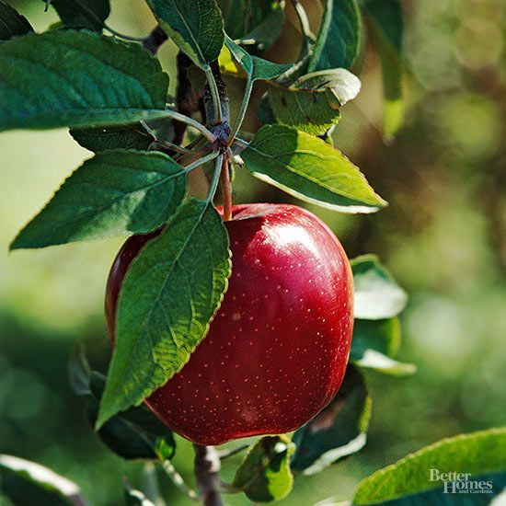
Plant Pathology 2021 - FGVC8
One Apple a day keep the Lecturer away

Slide 2
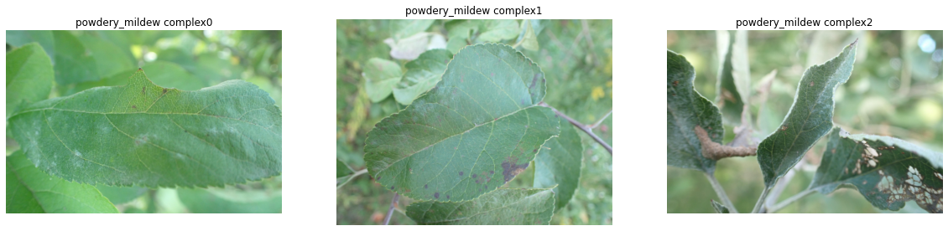
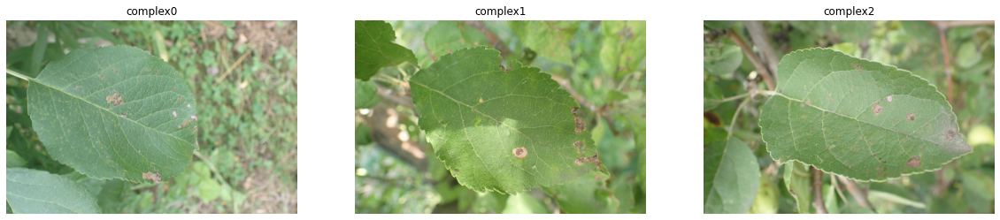
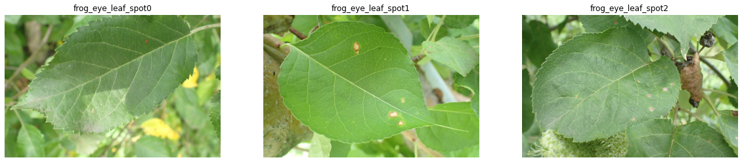
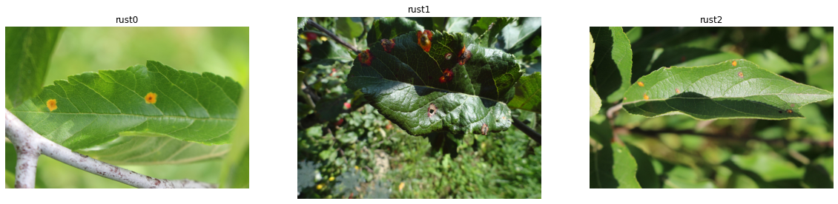
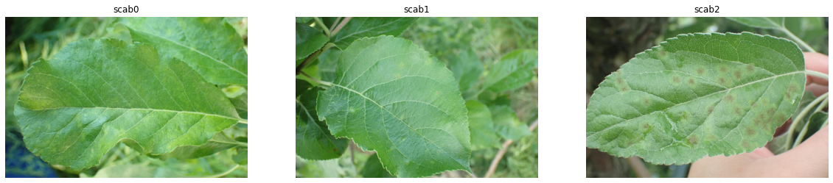
Problem Description
Powdery mildew
complex
Frog eye leaf spot
rust
scab
Notes:
Problem description
Apples are one of the most important temperate fruit crops in the world and it is considered one of the most popular fruits on the planet.
Apple orchards in the United States are under constant threat from a large number of pathogens and insects. The Foliar (leaf) diseases pose a major threat to the overall productivity and quality of apple orchards.

Slide 3
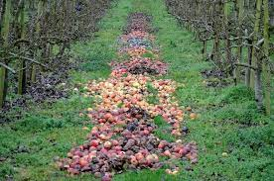
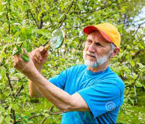
Solving need
Notes:
The current process for disease diagnosis in apple orchards is based on manual scouting by humans, which is time-consuming and expensive.
In addition, appropriate and timely deployment of disease management depends on early disease detection. Incorrect and delayed diagnosis can result in either excessive or inadequate use of chemicals, with increased production costs and increased environmental and health impacts.
The main objective of the competition is to develop machine learning-based models to accurately classify a given leaf image from the test dataset to a particular disease category, and to identify an individual disease from multiple disease symptoms on a single leaf image.

Slide 4
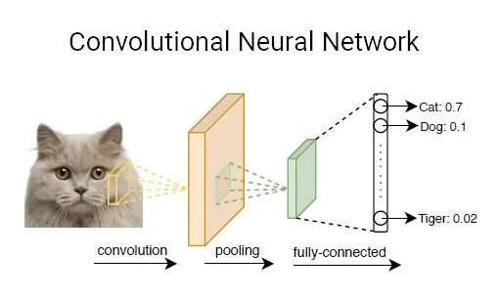
Problem Definition
There are multiple ways of solving image classification problem such as:
KNN, Fully connected Neural Networks and CNN.
Each method has its pros and cons like KNN doesn’t actually learning anything and for predict must to run over entire dataset, FC net .
We believe that we can achieve the best accuracy by using Convolutional networks.

Slide 5
The dataset
Notes:
The dataset contains approximately 23,000 high-quality RGB images(1000X1000) of apple foliar diseases, including a large expert-annotated disease dataset.
This dataset reflects real field scenarios by representing non-homogeneous backgrounds of leaf images taken at different maturity stages and at different times of day under different focal camera settings
מדענים בתחום החקלאות יצרו את הדאטא סט הזה

Slide 6
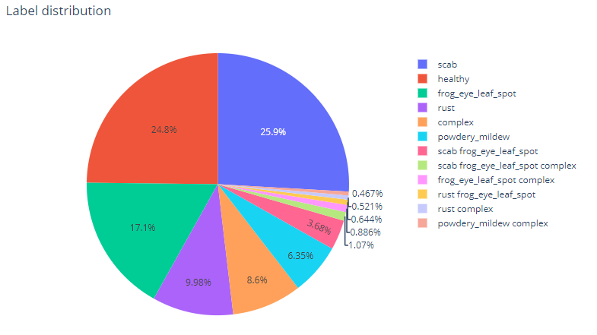
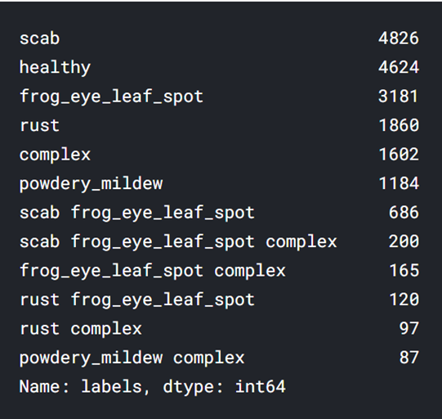
Exploratory data analysis
The dataset

Slide 7
Observations
We have multi-label data, which means that a leaf can have one disease or a couple of diseases.
This is an important observation because it defines for us the strategy of work and training with the data that will be detailed in milestones section.
It seems to that the Dataset is pretty unbalanced.
We need to choose the appropriate sampling strategy to sortout this issue.
The pictures were taken in different times of the day and under different focal camera settings.

Slide 8
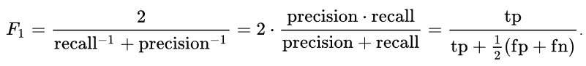
The Competition Score
The evaluation metric for the competition is Mean F1-Score.
The F1 Score is calculated from the precision and the recall.
Precision = the number True Positive samples divided by all Positive samples predicted.
Recall = the number True Positive samples divided by all Positive samples that should have been identified as positive.
The F1 equation is :
The conclusion:
We should try to erase the TP rate and reduce the FP and FN rates. The TN rate is not relevant for us.

Slide 9
Neural networks & Deep learning theory

Slide 10

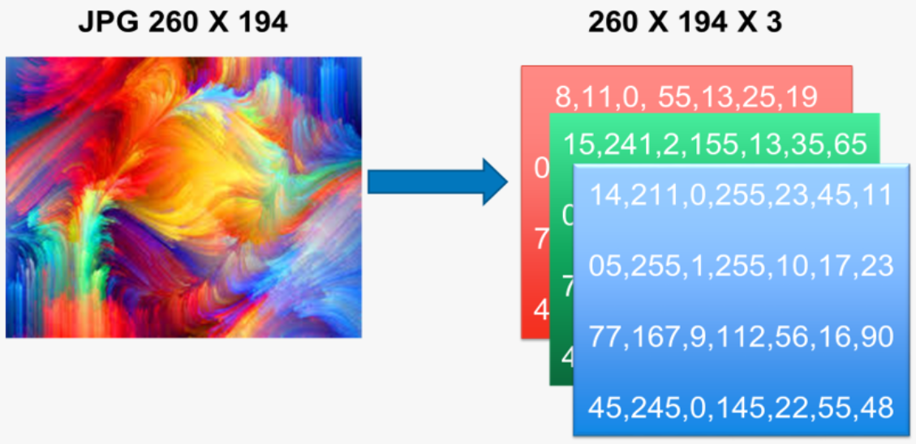
Computers don’t see images as humans do. They see a matrix of pixels, each of which has three components: red, green and blue (ever heard of RGB?)
Notes:
Motivation. The Image Classification problem, which is the task of assigning an input image one label from a fixed set of categories. This is one of the core problems in Computer Vision that, despite its simplicity, has a large variety of practical applications.

Slide 11
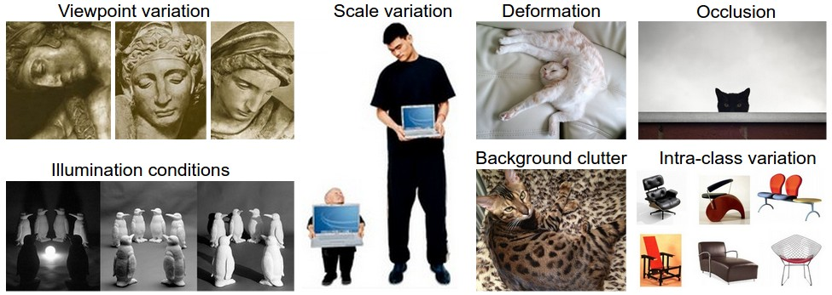
Notes:
Challenges. Since this task of recognizing a visual concept (e.g. cat) is relatively trivial for a human to perform, it is worth considering the challenges involved from the perspective of a Computer Vision algorithm. As we present (an inexhaustive) list of challenges below, keep in mind the raw representation of images as a 3-D array of brightness values:
Viewpoint variation. A single instance of an object can be oriented in many ways with respect to the camera.
Scale variation. Visual classes often exhibit variation in their size (size in the real world, not only in terms of their extent in the image).
Deformation. Many objects of interest are not rigid bodies and can be deformed in extreme ways.
Occlusion. The objects of interest can be occluded. Sometimes only a small portion of an object (as little as few pixels) could be visible.
Illumination conditions. The effects of illumination are drastic on the pixel level.
Background clutter. The objects of interest may blend into their environment, making them hard to identify.
Intra-class variation. The classes of interest can often be relatively broad, such as chair. There are many different types of these objects, each with their own appearance.

Slide 12
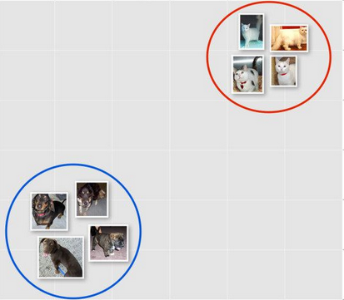

k - Nearest Neighbor Classifier
Notes:
find the top k closest images, and have them vote on the label of the test image
disadvantages:
The classifier must remember all of the training data and store it for future comparisons with the test data. This is space inefficient because datasets may easily be gigabytes in size.
Classifying a test image is expensive since it requires a comparison to all training images.

Slide 13

The diagram below shows a cartoon drawing of a biological neuron (left) and a common mathematical model (right).
Notes:
Each neuron receives input signals from its dendrites and produces output signals along its (single) axon. The axon eventually branches out and connects via synapses to dendrites of other neurons. In the computational model of a neuron, the signals that travel along the axons (e.g. x0) interact multiplicatively (e.g. w0x0) with the dendrites of the other neuron based on the synaptic strength at that synapse (e.g. w0). The idea is that the synaptic strengths (the weights w) are learnable and control the strength of influence (and its direction: excitory (positive weight) or inhibitory (negative weight)) of one neuron on another.

Slide 14
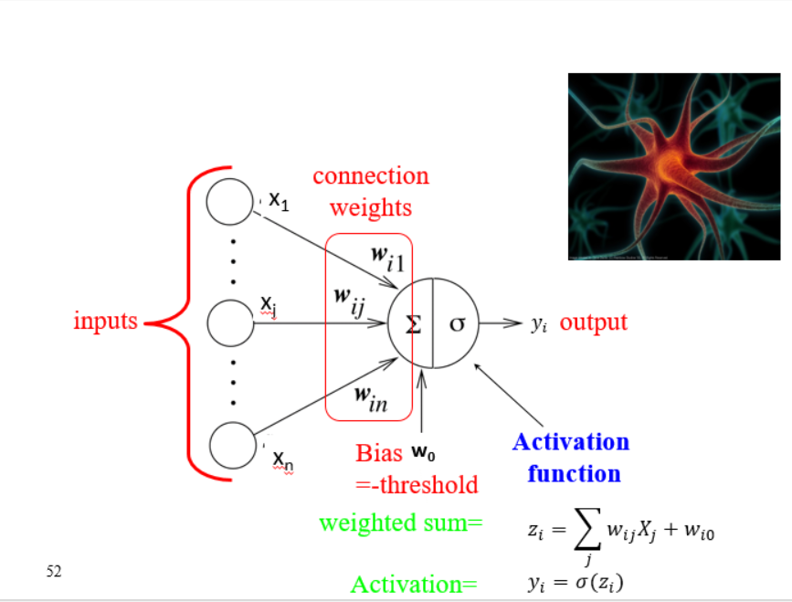
In the computer world..

Slide 15
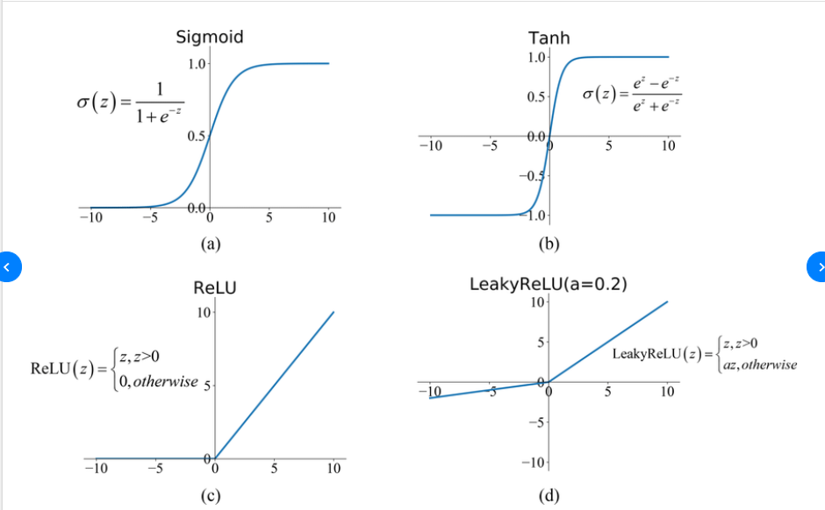
There are different activations functions…

Slide 16
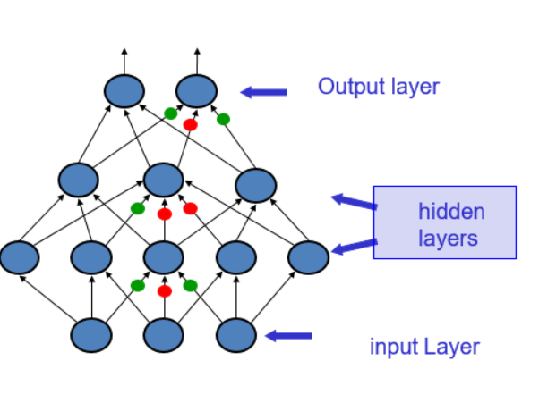
A simple neural network

Slide 17
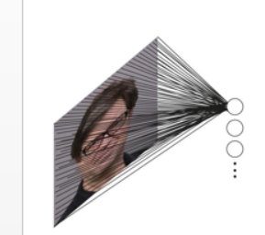
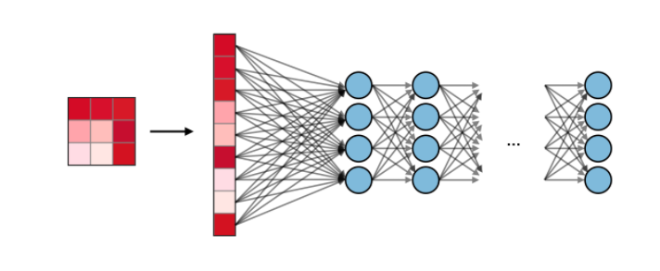
Fully connected Neural Networks
Notes:
Another interpretation for the weights
W
W is that each row of
W
W corresponds to a template (or sometimes also called a prototype) for one of the classes.
How we get the images

Slide 18


Notes:
Neural Networks are modeled as collections of neurons that are connected in an acyclic graph. In other words, the outputs of some neurons can become inputs to other neurons. Cycles are not allowed since that would imply an infinite loop in the forward pass of a network.

Slide 19
Convolutional Neural Network
So what are Convolutional Neural Networks?
They are a multi-layered neural network that is known to be able to detect patterns and complex features.
The convolutional layers encode multiple lower-level features into more discriminative features, in a way that is spatially context-aware.
In the world of image classifications the benefit of using a Convolutional Neural Network is that it is more efficient in terms of accuracy and speed.

Slide 20
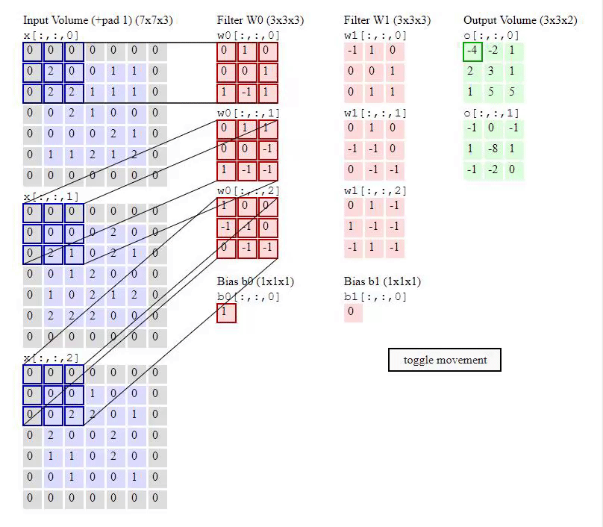

Slide 21


Slide 22
Literature review

Slide 23
Deep learning in agriculture: A survey
Smart farming is important for tackling the challenges of agricultural production in terms of productivity, environmental impact, food security and sustainability
The most popular techniques used for analyzing images include machine learning (ML) (K-means, support vector machines (SVM), artificial neural networks (ANN)
Besides the aforementioned techniques, a new one which is recently gaining momentum is deep learning (DL)
DL belongs to the machine learning computational field and is similar to ANN. However, DL is about “deeper” neural networks that provide a hierarchical representation of the data by means of various convolutions. This allows larger learning capabilities and thus higher performance and precision.
advantage of DL is feature learning, i.e. the automatic feature extraction from raw data, with features from higher levels of the hierarchy being formed by the composition of lower level features
Notes:
most papers (20) target crops, while few works consider issues such as weed detection (8 papers), land cover (4papers), research on soil (2 papers), livestock agriculture (3 papers),obstacle detection (3 papers) and weather prediction (1 paper).

Slide 24
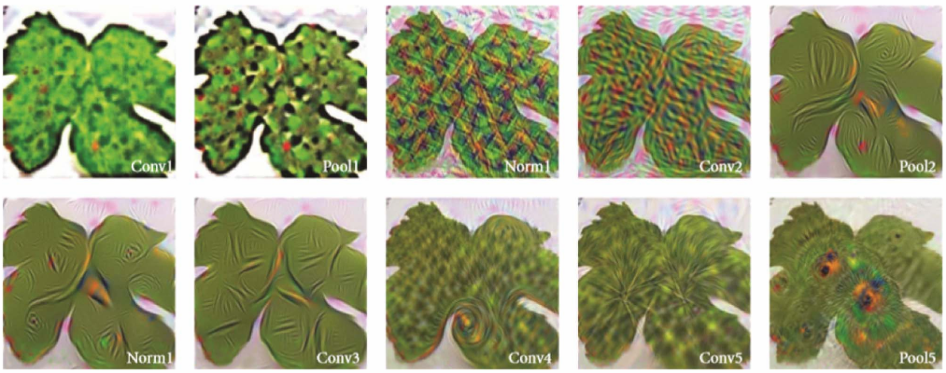
advance of CNN
Sixteen areas have been identified in total, with the popular ones being identification of weeds (5 papers), land cover classification (4 papers), plant recognition (4 papers), fruits counting (4 papers) and crop type classification (4 papers).
Almost half of the research works (17 papers, 42%) employed popular CNN architectures such as AlexNet, VGG16 and Inception-ResNet. From the rest, 14 papers developed their own CNN models, 2 papers adopted a first-order Differential Recurrent Neural Networks (DRNN) model, 5 papers use a Long Short-Term Memory (LSTM) model , one paper used deep belief networks (DBN) and one paper employed a hybrid of PCA with auto-encoders (AE)
at a problem of identifying plant diseases, is depicted in. We can observe that after each processing step, the particular elements of the image that reveal the indication of a disease become more evident, especially at the final step (Pool5).
Notes:
most papers (20) target crops, while few works consider issues such as weed detection (8 papers), land cover (4papers), research on soil (2 papers), livestock agriculture (3 papers),obstacle detection (3 papers) and weather prediction (1 paper).

Slide 25
Data augmentation
15 papers, 37% employed data augmentation techniques, to enlarge artificially their number of training images.This helps to improve the overall learning procedure and performance, and for generalization purposes, by means of feeding the model with varied data.
Transformations are label-preserving, and included rotations (12 papers), dataset partitioning/cropping (3 papers), scaling (3 papers), transposing , mirroring, translations and perspective transform ,adaptations of objects’ intensity in an object detection problem
common train methodology
Most of the studies divided their dataset between training and testing/verification data using a ratio of 80–20 or 90–10 respectively.
In addition, various learning rates have been recorded, from 0.001 and 0.005 up to 0.01. Learning rate is about how quickly a network learns. A general approach used by many of the evaluated papers is to start out with a high learning rate and lower it as the training goes on. We note that learning rate is very dependent on the network architecture.
most of the research works that incorporated popular DL architectures took advantage of transfer learning which concerns leveraging the already existing knowledge of some related task or domain in order to increase the learning efficiency of the problem under study by fine-tuning pre-trained models.
Notes:
Higher values help avoid the solver being stuck in local minima,which can reduce performance significantly.

Slide 26
performance comparison with other approaches
We focus only on comparisons between techniques used for the same dataset at the same research paper, with the same metric.
CNN show 1–8% higher CA in comparison to SVM
41% improvement of CA when compared to ANN (fully connected)
Examining agricultural areas where DL techniques have been applied, leaf classification, leaf and plant disease detection, plant recognition and fruit counting have some papers which present very good performance (i.e. CA > 95%, F1 > 0.92 or RFC > 0.9)

Slide 27
Disadvantages and limitations of deep learning
drawback and barrier in the use of DL is the need of large datasets, which would serve as the input during the training
A big problem with many datasets is the low variation among the different classes
data annotation is a necessary operation in the large majority of cases, some tasks are more complex and there is a need for experts
limited availability of resources and expertise
affected by environmental factors such as wrinkled surface and insect damages.
Difficulty in detecting heavily occluded ancd distant objects
A general issue in computer vision, not only in DL, is that data pre-processing is sometimes a necessary and time-consuming task
Conclusion
The findings indicate that deep learning offers better performance and outperforms other popular image processing technique

Slide 28
The Plant Pathology 2020 challenge dataset to classify foliar disease of apples
Apple orchards are in constant threat by a large number of pathogens and insects, incorrect and delayed diagnosis can lead to high usage of chemicals and increased production cost and health impacts.
From the article we can see that they used CNN and achieved 97.62% accuracy in detecting the diseases of the plants.
Currently the plant detection is done manually by humans and require a lot of expertise and training to detect everything also there aren't many people who can fully diagnose every single disease therefore resulting in a lot of time and money spent to try to achieve the best result.
People train themselves the way we training our model by going over picture of different diseases and trying to remember every single one of them.
When using computer vision as a tool for precise disease identification, all potential symptom variables must be accounted for in the digital image database when capturing images for the database it should be in high quality from different angles and conditions so the computer can detect them.
The dataset was randomly split into training and stratified test set of 80% and 20%, respectively, such that
both datasets have all four disease categories.
Deep learning methods such as deep convolutional neural networks are yielding unprecedented accuracy on visual recognition tasks. However, the disease recognition problem is distinct from standard applications of deep learning where there are multiple observations of each object from varying angles. The visual features that define a disease
can be small or subtle, localized, and often, symptoms of more than one disease are present on a single leaf.
https://paperswithcode.com/paper/the-plant-pathology-2020-challenge-dataset-to

Slide 29
We can see from the article that using CNN (ResNet50) can lead to the most accurate result, and were looking to recreate the same results with the same method.
The results of the tests from the article are that 97% of the pictures were correctly categorized expect the "complex disease patterns"(combination of few diseases) which was classified only to 51%.
The Plant Pathology 2020 challenge dataset to classify foliar disease of apples
https://paperswithcode.com/paper/the-plant-pathology-2020-challenge-dataset-to

Slide 30
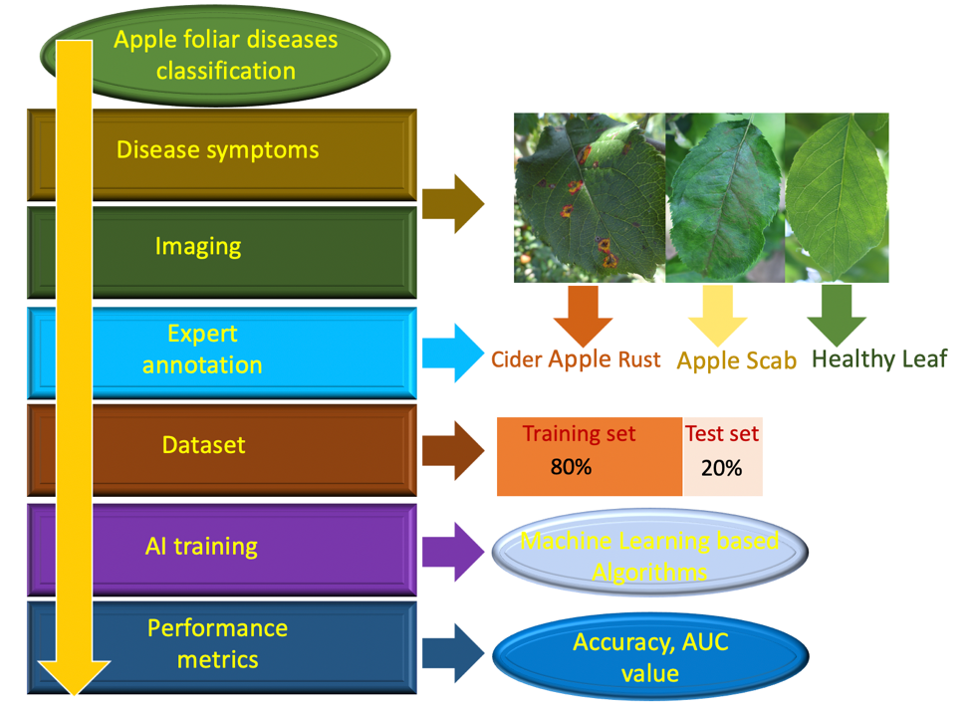

Slide 31
Milestones

Slide 32
The Work Plan:
Data Pre-Processing
Model Selection
Optimizing Hyper parameters
Model Training & Validation
Model Testing
The plan that will be detailed now is based on solving the problems that we have:
Problems:
Multi-label Data
Unbalanced Data

Slide 33
Data Pre-Processing
This phase includes all the pre process we need to do in order to prepare the data for training.
The steps in this phase includes:
Using Augmentations
Multi-Label Solving Strategy

Slide 34
Augmentations
Augmentations is a technique for adding noises pictures and by that adding more noisy pictures from existing pictures. Augmentations are good for reducing the Bias error (reducing overfit) and for increasing the amount of pictures in the data. In our project, we will use augmentations for:
1) Adding more pictures to the lower frequencies categories for reducing the unbalance problem in our data.
2) Generalize the model and Improve results
There are several standard augmentations such as Blur, MotionBlur, MedianBlur, RandomBrightness, RandomContrast and More. Blur Augmentations are used for reducing the model dependence on clear and sharp images. Color Augmentations are used for create images with different colors. There are more Augmentations that manipulate pictures like rotation,flipping and more.
It is important to understand that not all augmentations are efficient for a data set, and we should be careful when using them. Using undisclosed augmentations may result in the destruction of the dataset and harm the results.
We need to choose Augmentations that are efficient for our data set.

Slide 35
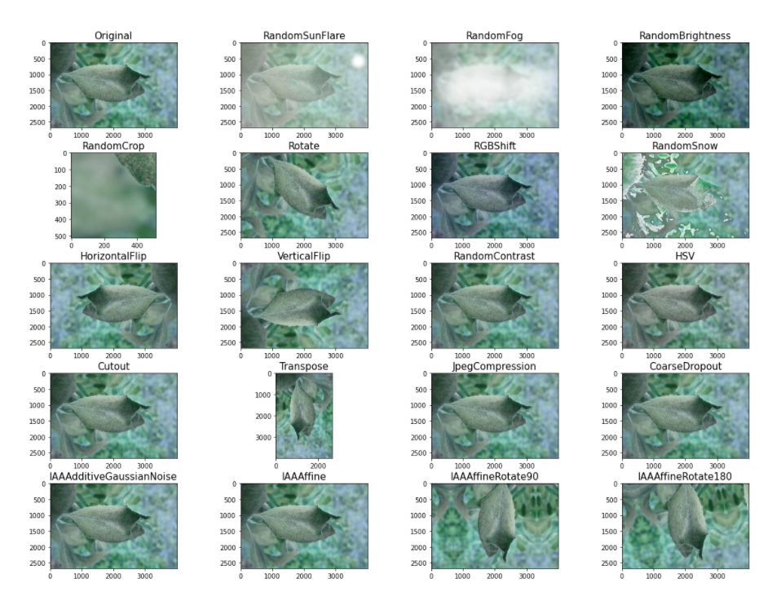

Slide 36
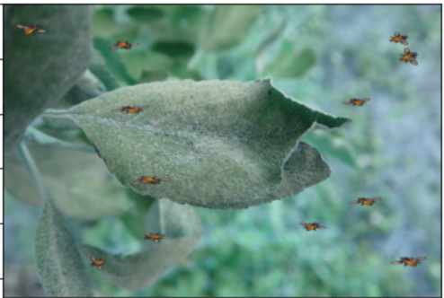
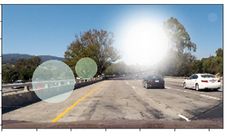
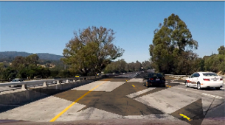
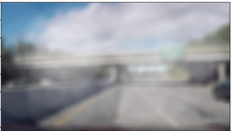
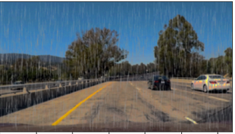
Suggested Augmentations
In our case, we are dealing with leafs in the nature. Therefore we need augmentations that mimic natural conditions. Such augmentations includes adding insects to pictures and weather. We we will also add other standard augmentations but we will not use color augmentations.
Two reasons for that are:
Color changing is not a phenomenon that happens in the nature.
The identification of leaf disease are color based and we may destroy the data set by playing the the RGB channels.

Slide 37
Multi-Label Solving Strategy
As we already know, we have a multi-label data. Therefore we need a model that will be capable to predict multiply diseases on a leaf. Usually classification problems includes unique and categorical labels. What can we do?
Our approach to solving the problem is to create a type of one hot vectors and use them as labels in the training data. Each index in the vector represents a disease in the leaf.
Index 0 - ‘healthy’
Index 1 - ‘scab’
Index 2 - ‘frog_eye_leaf_spot’
Index 3 - ‘rust’
Index 4 - ‘complex’
Index 5 - ‘powdery_mildew’
Value of 1 means that the disease exists in the leaf
Value of 0 means that the disease does not exists in the leaf
Example: Suppose we have a leaf that contains the scab and rust disease, the label will look like this: [0,1,0,1,0,0]

Slide 38
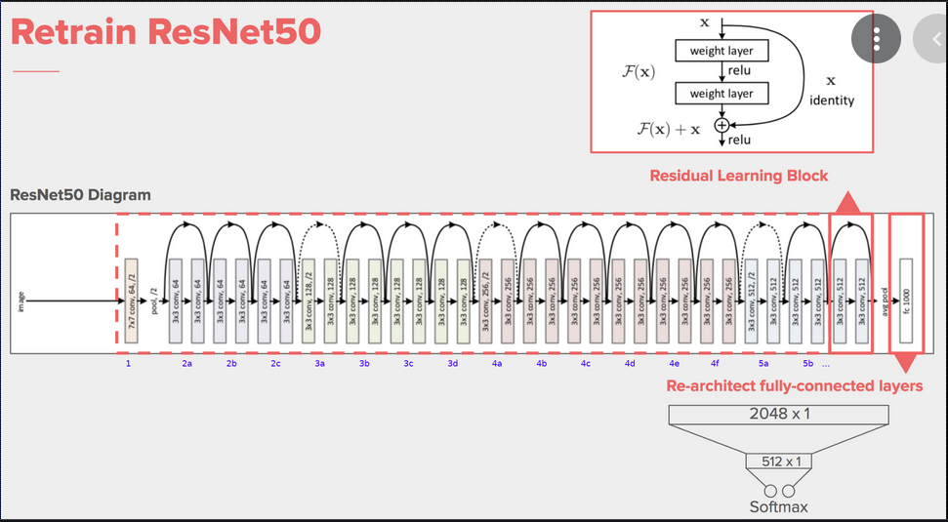
Selecting a Model
We chose the ResNet50 model, based on the paper we have seen above. We aim to gain better results that those who were reached in the paper.

Slide 39
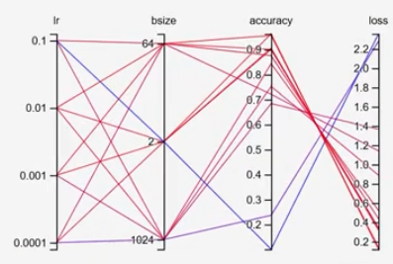
Optimizing Hyper parameters

Slide 40
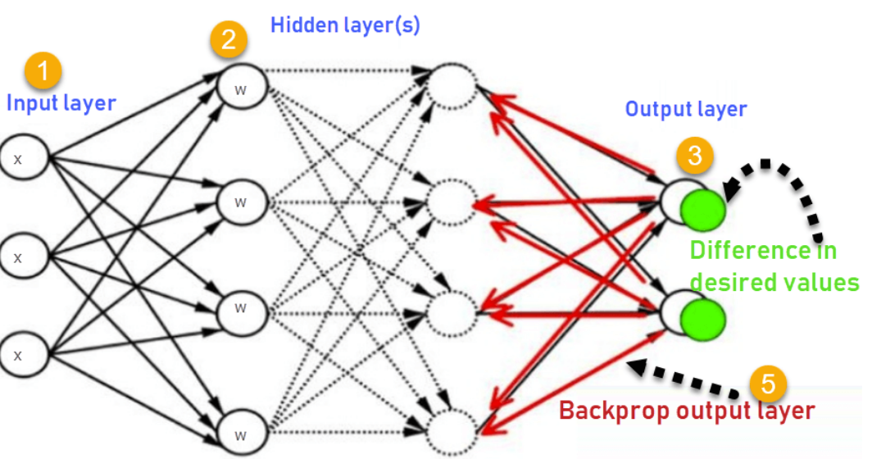
Model Training & Validation
In the deep learning world, the training is performed by an algorithm called Backpropagation. Backpropagation computes the gradient in weight space of a feedforward neural network, with respect to a loss function.

Slide 41
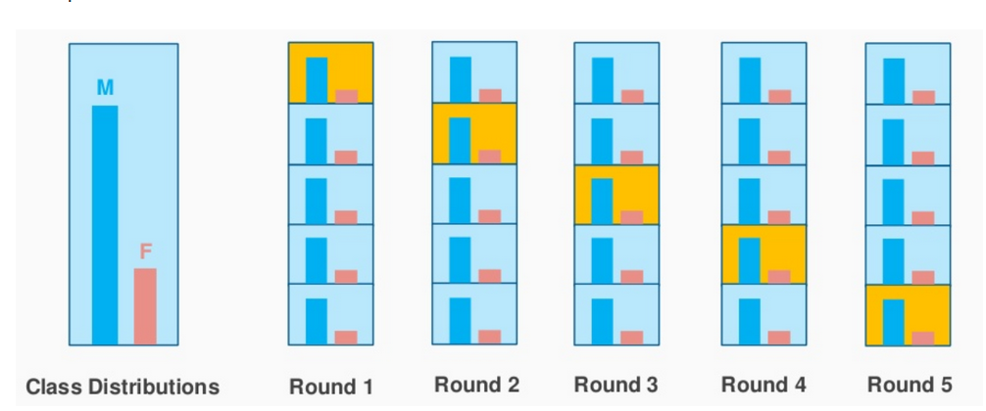
Our Cross validation method will be: K-fold stratified

Slide 42
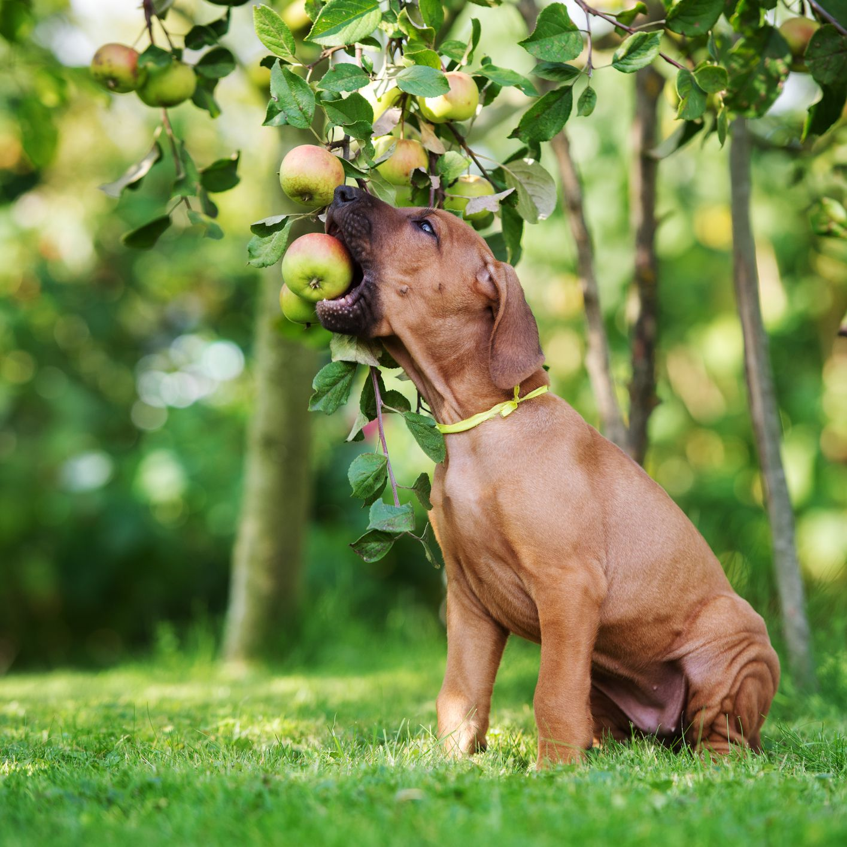
Thank You For Listening

